Slide 1

E MESSAGE OF THE CROSS IS FOOLISHNESS TO THOSE WHO ARE PERISHING, BUT TO US WHO ARE BEING SAVED IT IS THE POWER OF GOD” (1 CORINTHIANS 1:18, NIV).

Slide 2
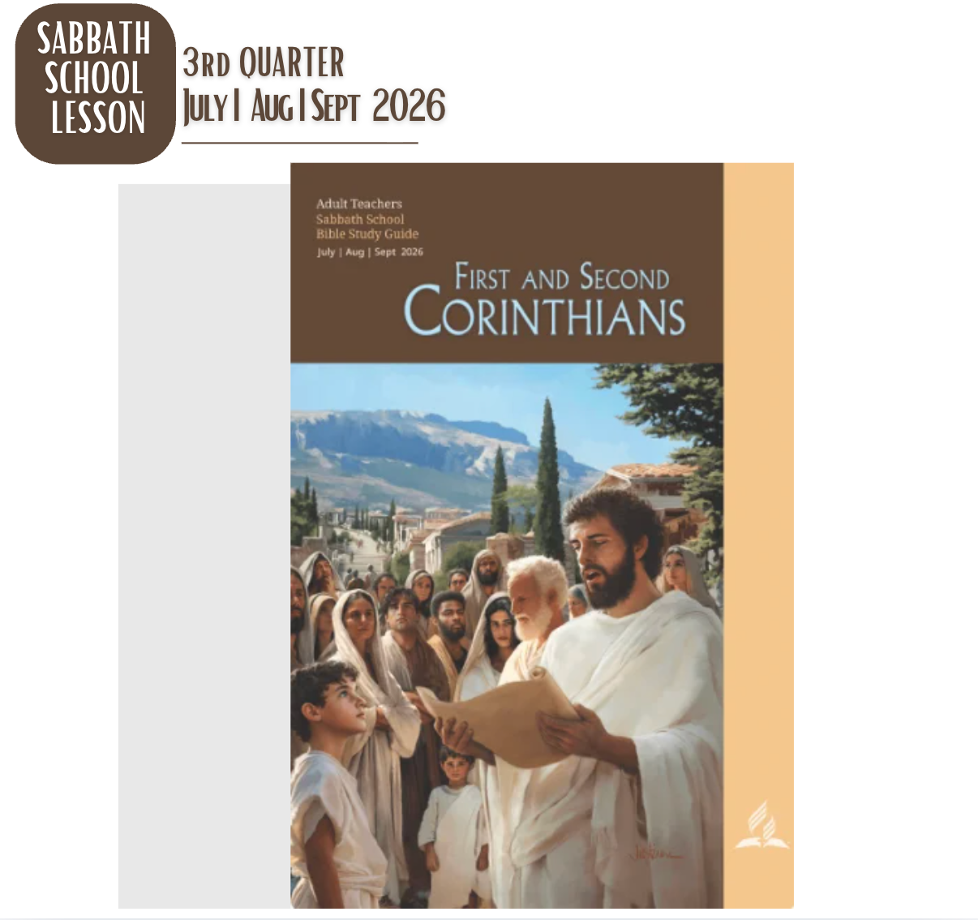

Slide 3
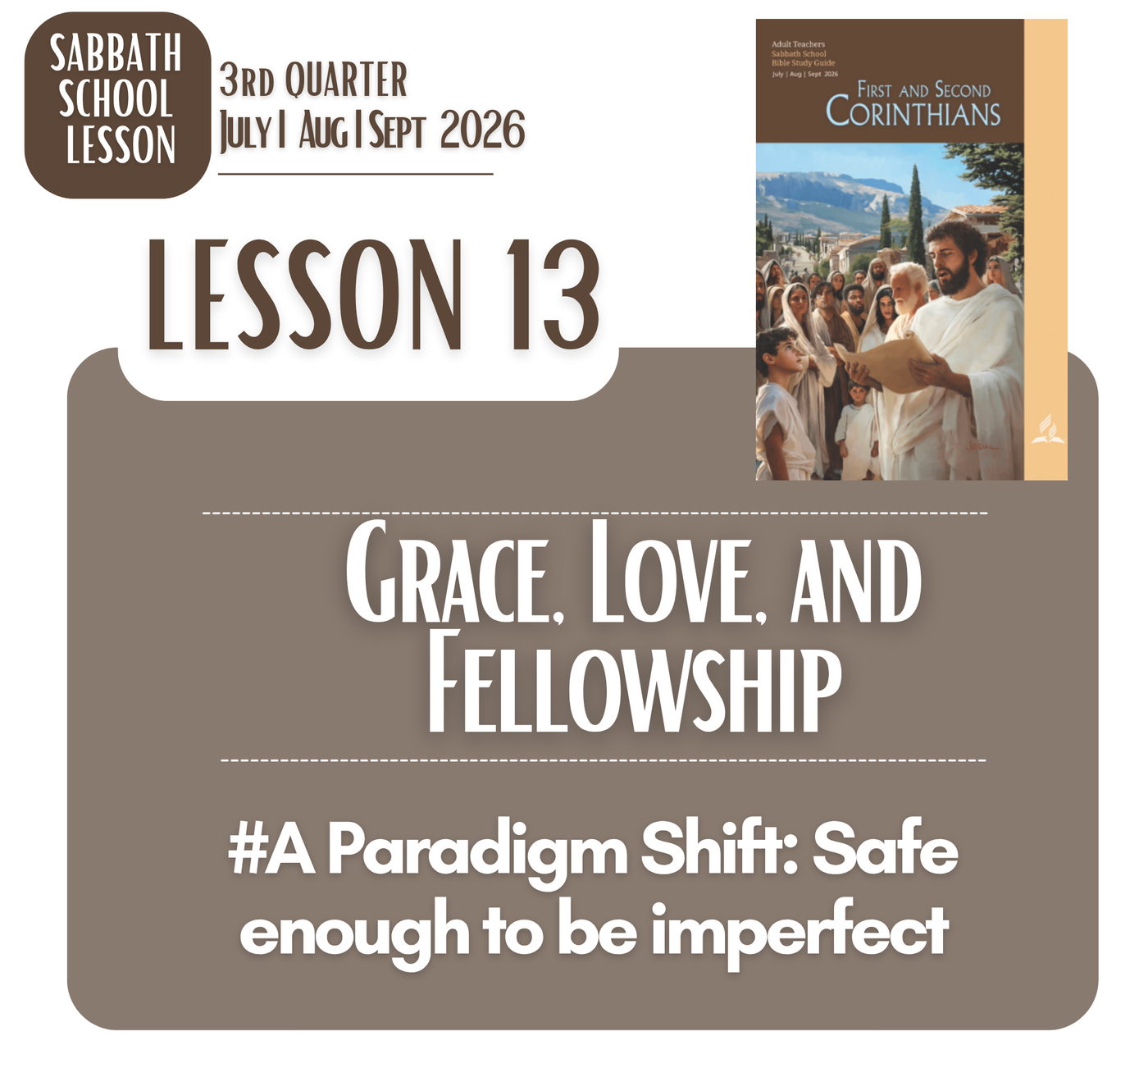

Slide 4

LESSON 13 - GRACE, LOVE, AND FELLOWSHIP
MEMORY TEXT
"The grace of the Lord Jesus Christ and the love of God and the fellowship of the Holy Spirit be with you all"
(2 Corinthians 13:14, ESV).

Slide 5
LESSON 13 - GRACE, LOVE, AND FELLOWSHIP
OPENING POINTS
God Seeing the true me
God sees the person beneath our strength, achievements, defenses, and failures. Nothing about us is hidden from Him, yet Christ does not respond with rejection. He sees our weakness with compassion and invites us to become vulnerable enough to receive His transforming grace.
When God sees the true me, I no longer need to protect an image of perfection. His love gives courage to acknowledge my brokenness and embrace change. In Christ, vulnerability becomes strength, because I can face who I am while trusting who He is becoming in me.

Slide 6
LESSON 13 - GRACE, LOVE, AND FELLOWSHIP I SATURDAY AFTERNOON
INTRODUCTION
Paul’s imperatives are not demands for flawless Christians but invitations to people still being restored. Human weakness easily produces conflict, discouragement, and division. Yet Christ meets imperfect people with grace, transforming wounded relationships through His patience, presence, and reconciling love.
God’s presence is not earned by our ability to maintain perfect unity. Rather, the Triune God creates unity through grace, love, and fellowship. When human weakness overwhelms us, Christ remains our center, enabling restoration, encouragement, peace, and genuine community beyond our limitations.

Slide 7
LESSON 13 - GRACE, LOVE, AND FELLOWSHIP I SUNDAY
The Grace of Jesus
Gospel
THEMES
Grace is not merely God’s response to our failures; it reveals how deeply He sees and values us. Jesus willingly entered our poverty, weakness, and brokenness. His grace meets us without pretending we are strong, inviting vulnerable hearts to trust His love.
Gospel
LIFE
Paul’s repeated emphasis on grace reminds us that transformation begins with receiving, not performing. We may struggle, fall, resist, and feel unworthy, yet Christ remains sufficient. His grace does not excuse our brokenness; it creates the safety to face it honestly and become willing to change.

Slide 8
LESSON 13 - GRACE, LOVE, AND FELLOWSHIP I SUNDAY
The Grace of Jesus
ANSWER TO THE MAIN QUESTIONS
Q: Think about God's grace toward you like this. What do you deserve for the kind of things that you have said and done? What, however, does God's grace offer you instead?
ANSWER:
When I honestly face my words, choices, and failures, I recognize that I deserve the consequences of my wrongs, yet God does not define me by them. His grace offers forgiveness, restoration, and a relationship I could never earn. In Christ, God meets my weakness without denying its reality. He invites me to stop hiding, receive His mercy, and become willing to change, trusting His love more than my failures.

Slide 9
LESSON 13 - GRACE, LOVE, AND FELLOWSHIP I MONDAY
The Love of God
Gospel
THEMES
God’s love sees beyond our failures, defenses, and inconsistencies. While we were still sinners, Christ died for us, revealing a love that does not wait for worthiness. This love creates safety to face our weakness honestly, because God’s heart moves toward us, not away.
Gospel
LIFE
If God’s love becomes the center, unity is no longer maintained by pretending everything is fine. We can acknowledge wounds, differences, and failures while remaining open to one another. Christ teaches us that genuine love does not demand perfection; it patiently creates space for restoration.

Slide 10
LESSON 13 - GRACE, LOVE, AND FELLOWSHIP I MONDAY
The Love of God
ANSWER TO THE MAIN QUESTIONS
Q: What would we lose in the gospel if Jesus Himself were not fully and eternally God?
ANSWER:
If Jesus were not fully and eternally God, the gospel would lose its revelation of who God truly is and the assurance that God Himself entered our brokenness to save us. His incarnation, sacrifice, and grace would become less than God’s own self-giving love. Because Christ is fully God, His cross reveals that our salvation is not distant or conditional, but God personally drawing near to restore humanity to Himself.

Slide 11
LESSON 13 - GRACE, LOVE, AND FELLOWSHIP I TUESDAY
The God of Love
Gospel
THEMES
God is not merely a God who gives love; He is the God of love. This means our weakness does not make us objects of divine anger, but people invited into relationship. In Christ, we encounter God’s love personally, where wounded hearts can find peace, belonging, and hope.
Gospel
LIFE
The Trinity reveals that love is relational at God’s very being. Therefore, Christian community cannot be built through perfection or performance. We remain imperfect, sometimes defensive and wounded, yet God patiently teaches us to receive His love, become vulnerable, and extend that same grace toward others.

Slide 12
LESSON 13 - GRACE, LOVE, AND FELLOWSHIP I WEDNESDAY
The Fellowship of the Holy Spirit
Gospel
THEMES
The Spirit does not merely empower us; He accompanies us in our weakness. He knows the depths of our hearts and patiently works within our limitations. Fellowship begins when we stop pretending strength, allowing the Spirit to meet us honestly and transform us from within.
Gospel
LIFE
True fellowship cannot be manufactured through agreement, activity, or religious performance. The Spirit creates communion by drawing imperfect people toward Christ and one another. When we are defensive, wounded, or divided, His presence gently opens our hearts to receive grace, practice vulnerability, and grow together.

Slide 13
LESSON 13 - GRACE, LOVE, AND FELLOWSHIP I WEDNESDAY
The Fellowship of the Holy Spirit
ANSWER TO THE MAIN QUESTIONS
Q: Why, too, is an understanding of the divinity of the Holy Spirit important for fully grasping God's love for us?
ANSWER:
Understanding the Holy Spirit as fully divine shows that God’s love is not distant or merely historical. The same divine God who planned salvation and revealed Himself in Christ also personally dwells with us through the Spirit. This means God does not simply send help; He gives Himself to us. The Spirit makes Christ’s grace present, comforts our weakness, transforms our hearts, and assures us that God remains intimately with us.

Slide 14
LESSON 13 - GRACE, LOVE, AND FELLOWSHIP I THURSDAY
Our Triune God
Gospel
THEMES
The Triune God does not relate to us in fragments, but together in one saving purpose. When we feel divided, weak, or spiritually inadequate, the Father, Son, and Spirit meet us with grace, love, and fellowship, assuring us that salvation rests on God’s initiative.
Gospel
LIFE
This divine unity gives hope to imperfect people. We often struggle to understand ourselves, others, and even God, yet the Triune God patiently draws us into relationship. Christ reveals the Father’s heart, while the Spirit makes that grace present, transforming our vulnerability into communion.

Slide 15
LESSON 13 - GRACE, LOVE, AND FELLOWSHIP I THURSDAY
Our Triune God
ANSWER TO THE MAIN QUESTIONS
Q: How should fellowship among church members reflect the lovely relationship of the Godhead?
ANSWER:
Fellowship should reflect the Godhead through self-giving love, humility, patience, and genuine care. Since the Father, Son, and Spirit exist in perfect relationship, church members are invited to welcome one another without demanding perfection. We should create spaces where people can be vulnerable, heard, forgiven, and restored. Christ-centered fellowship does not erase differences or weaknesses; it allows grace to hold us together while the Spirit patiently transforms us into deeper unity.

Slide 16







LESSON 13 - GRACE, LOVE, AND FELLOWSHIP
Gospel Reality!
GOD IS LOVE AND THERE IS NO OTHER MUCH BIGGER REALITY!
GOOD NEWS
#A Paradigm Shift: Safe enough to be imperfect

Slide 17

LESSON 13 - GRACE, LOVE, AND FELLOWSHIP
HEART
of
the
Gospel
#A Paradigm Shift: Safe enough to be imperfect
Grace calls us to shift from performance to receiving, from performing to belonging. Instead of believing that we must become worthy before approaching God, we discover that Christ meets us in our weakness. His grace gives us freedom to acknowledge who we truly are, without hiding, pretending, or earning the right to be loved.

Slide 18
LESSON 13 - GRACE, LOVE, AND FELLOWSHIP
HEART
of
the
Gospel
#A Paradigm Shift: Safe enough to be imperfect
Love and fellowship shift us from judgment and isolation toward belonging and vulnerability. When we experience God’s love, we can create spaces where others are safe to be imperfect, honest, and changing. Fellowship means creating space where people can speak honestly, struggle openly, receive correction gently, and grow patiently. We do not celebrate brokenness, but we make room for grace to restore people while Christ continues transforming them.

Slide 19
LESSON 13 - GRACE, LOVE, AND FELLOWSHIP
HEART
of
the
Gospel
#A Paradigm Shift: Safe enough to be imperfect
Through the Spirit, fellowship becomes more than gathering; it becomes a community where grace restores, love embraces, and Christ transforms.
Jesus is not only the One who welcomes the imperfect; He is the One who patiently transforms us, until our lives increasingly reflect His grace, love, and character.

Slide 20
LESSON 13 - Grace, Love, and Fellowship
ANSWERS TO FRIDAY’S DICUSSION QUESTIONS:
Q1 : A well-known Christian song is entitled "Amazing Grace." What is amazing about the grace of Jesus?
ANSWER:
The grace of Jesus is amazing because He gives what we could never earn. He enters our brokenness, carries our sin, and offers forgiveness, restoration, and new life. His grace does not wait until we become worthy; it meets us in our weakness. Christ sees the true me, yet still loves me, inviting me to stop hiding, receive His mercy, and become willing to change through His transforming love.

Slide 21
LESSON 13 - Grace, Love, and Fellowship
ANSWERS TO FRIDAY’S DICUSSION QUESTIONS:
Q2 : A beautiful portrayal of God's love can be found in the parable of the prodigal son. How do we know the father in this parable is a loving father?
ANSWER:
We know the father is loving because he does not stop loving his son when the son leaves, fails, and returns broken. He watches, welcomes, embraces, restores, and celebrates him without humiliation. His response reveals God’s heart: love does not deny our failures, but meets our vulnerability with compassion, dignity, forgiveness, and an open invitation to return home.

Slide 22
LESSON 13 - Grace, Love, and Fellowship
ANSWERS TO FRIDAY’S DICUSSION QUESTIONS:
Q3 : How can local churches demonstrate that the "fellowship of the Spirit" is a reality there?
ANSWER:
Local churches demonstrate the fellowship of the Spirit when people are safe to be honest, vulnerable, and imperfect without fear of rejection. The Spirit creates a community where members listen, encourage, forgive, serve, and restore one another. Fellowship becomes real when differences do not destroy relationships, because Christ remains the center and His love teaches us to see people with compassion rather than judgment, making room for growth and transformation.

