Slide 1
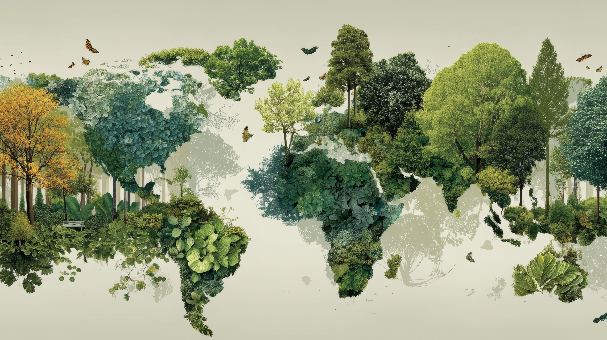



SHORT DEVOTIONAL THOUGHTS
Day 11
Psalm 75
Why do humans still boast?

Slide 2
Day 11
SHORT DEVOTIONAL THOUGHTS
Psalm 75
CREATION VERSES
Why do humans still boast?
Psalm 75:1-3
1 We praise you, God, we praise you, for your Name is near; people tell of your wonderful deeds.
2 You say, “I choose the appointed time; it is I who judge with equity.
3 When the earth and all its people quake, it is I who hold its pillars firm.

Slide 3
Day 11
SHORT DEVOTIONAL THOUGHTS
Psalm 75
REFLECTIONS
Why do humans still boast?
Psalm 75 brings to us Asaph’s eyes against the arrogance of humanity. Asaph’s heart leans towards making those who lift themselves up forget their place as God’s created beings. Humanity, darkened with sin, is blind. Humanity is blind to its own vulnerability.

Slide 4
Day 11
SHORT DEVOTIONAL THOUGHTS
Psalm 75
REFLECTIONS
Why do humans still boast?
A single leap of achievement can inflate our very fragile egos. In a single mark of success, we place ourselves on the highest pedestal to proclaim who we are, establish territory, dominion, and control.
This is humanity, this is exactly us apart from the workings of God in each of our lives.

Slide 5
Day 11
SHORT DEVOTIONAL THOUGHTS
Psalm 75
REFLECTIONS
Why do humans still boast?
Asaph points us to the center of his thanksgiving, and that is not his achievements, not his accomplishments, and not his works, but the works of his God. “For in the hand of the Lord there is a cup, and the wine is red; it is full of mixture; and he poureth out of the same: but the dregs thereof, all the wicked of the earth shall wring them out, and drink them” (v. 8).

Slide 6
Day 11
SHORT DEVOTIONAL THOUGHTS
Psalm 75
REFLECTIONS
Why do humans still boast?
We do not need any persuasion to exalt ourselves every time we do good. This is our nature, what we are capable of. However, despite human surety of its fleets and flights, Asaph declares no one who exalts himself or herself will ever stay on top.

Slide 7
Day 11
SHORT DEVOTIONAL THOUGHTS
Psalm 75
REFLECTIONS
Why do humans still boast?
Everyone who exalts themselves will be humbled and, sooner or later, learn the very important biblical truth that the top is a position occupied only by God. We are not designed to be on top and above everyone else.

Slide 8
Day 11
SHORT DEVOTIONAL THOUGHTS
Psalm 75
REFLECTIONS
Why do humans still boast?
We are designed to think of others, to care for others, and to make sure others also have the same opportunities as we do.

Slide 9
Day 11
SHORT DEVOTIONAL THOUGHTS
Psalm 75
Why do humans still boast?
KEEP LOOKING TO THE WORKS AND THE LOVE OF OUR CREATOR GOD!

