Slide 1


Slide 2
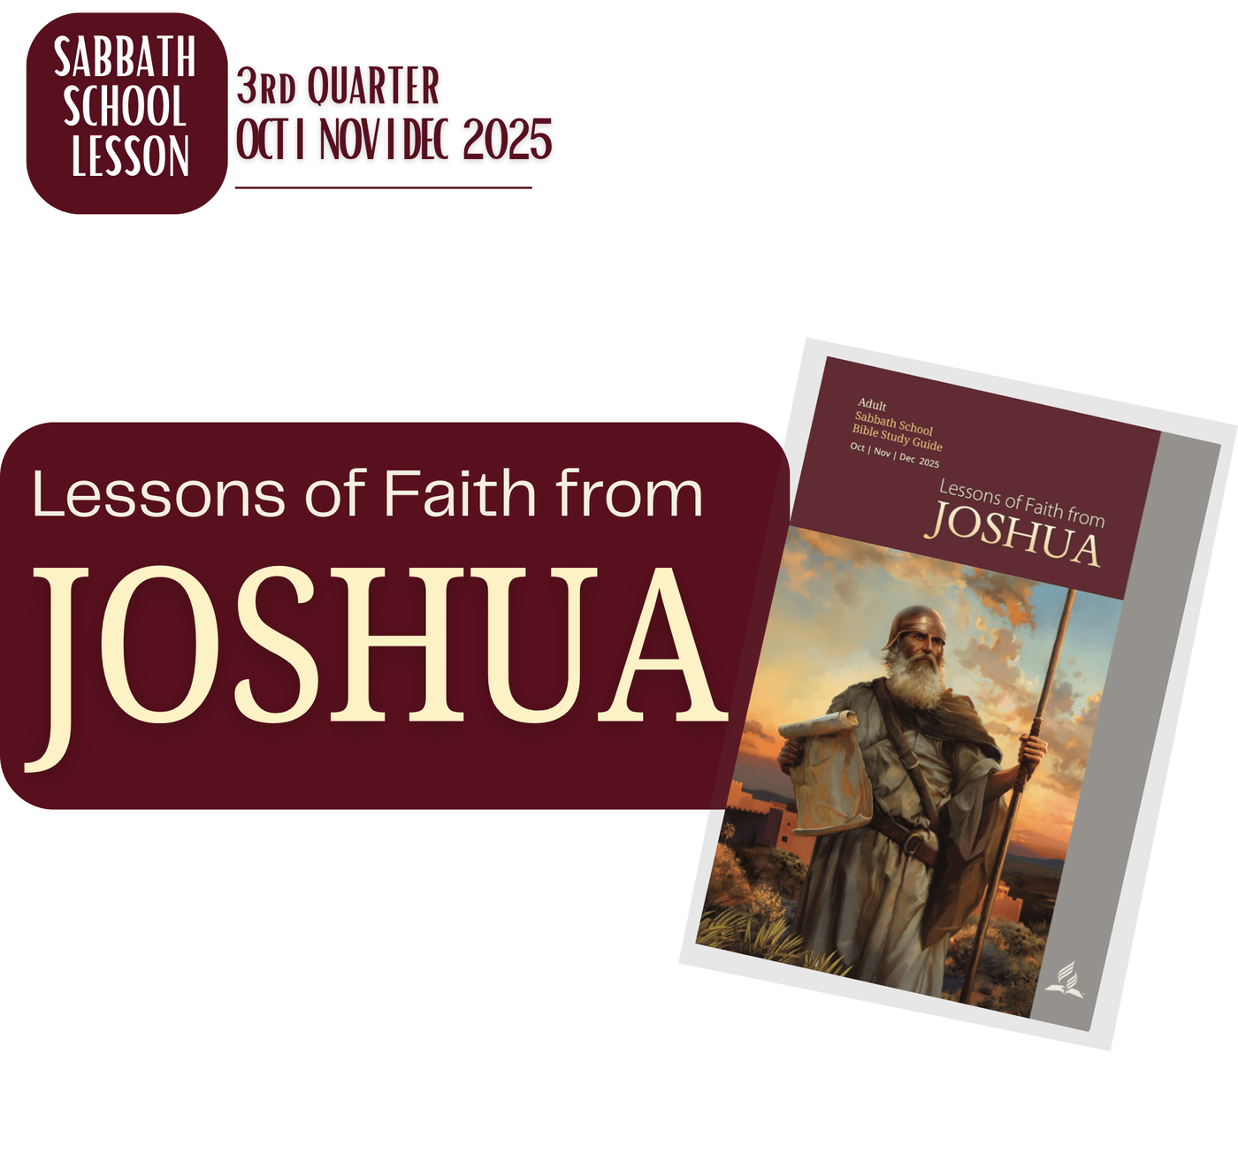

Slide 3
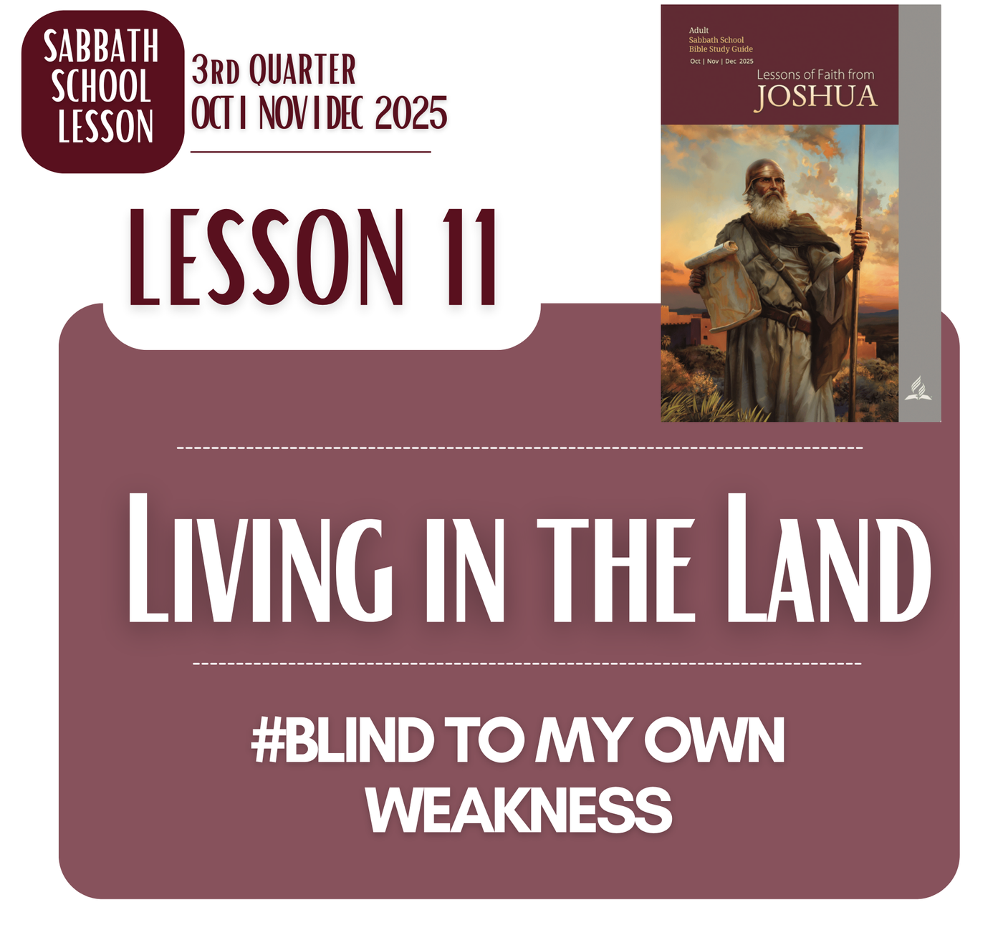

Slide 4

LESSON 11: LIVING IN THE LAND
MEMORY TEXT
“A gentle answer turns away wrath, but a harsh word stirs up anger.”
Proverbs 15:1, NIV

Slide 5

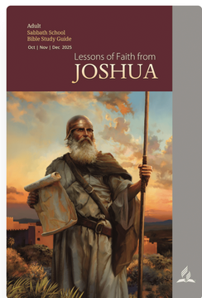
LESSON 11: LIVING IN THE LAND
OPENING POINTS
JESUS SEES I CAN NEVER COMMIT WITHOUT HIM
JESUS’S GENTLE ANSWER AND MY QUICK TEMPER
GOD KNOWS I CAN’T STICK TO THE PLAN
GOD’S GENTLENESS VS MY HARSH SPIRIT
JESUS AND MY HEART THAT IS FULL OF ACCUSATIONS
JESUS AND MY HEART, WHO IS NOT QUICK TO FORGIVE
GOD AND HOW HE DEALS WITH MY FAULTFINDING
GOD’S HEART WHEN I JUMP INTO CONCLUSION
JESUS AND THE HORROR OF MY PAST
GOD DOES NOT SEE ME IN MY PAST
#BLIND TO MY OWN WEAKNESS

Slide 6
LESSON 11: LIVING IN THE LAND
BACKGROUND
MY HUMAN HEART FIND IT EASIER TO ACCUSE
My human heart easily slips into the habit of accusing and judging others. I notice every mistake, every misstep, and every flaw, often magnifying them in my mind while excusing my own failures. I can replay wrongs, carry grudges, and let suspicion grow into bitterness, all without even realizing how much damage it causes to my relationships and my own peace of mind. It feels safer to find fault than to confront my own shortcomings, and I am often blind to how harsh my thoughts and words can be.
Yet this tendency is part of my weakness, my natural inclination to protect myself, to control situations, and to measure others by standards I struggle to meet myself. Without intervention, this heart of accusation can isolate me, harden me, and distort the way I love and serve others.

Slide 7
LESSON 11: LIVING IN THE LAND I SATURDAY AFTERNOON
INTRODUCTION
Living in community exposes our human weaknesses, how quickly we assume, misunderstand, and judge. Joshua 22 shows HOW WE EASILY RUSH INTO CONCLUSIONS. Yet in these moments, God meets us with patient love. Jesus enters our brokenness and teaches us a better way, WHERE:
  Weaknesses are not hidden but healed
  We slow down, listen, and remember that every believer is a broken person
  Personal preferences fade, and the mission becomes clear
  Unity is preserved not by flawless people but by faithful surrender to God’s purpose
  WE ADMIT THAT WE are all weak, all needy, and all loved
  ONLY LOVE CAN HOLD A COMMUNITY TOGETHER

Slide 8
LESSON 11: LIVING IN THE LAND I SUNDAY
Commitment
MAIN THOUGHT
Joshua 22:1–8; Deut. 2:14; Eph. 6:7, Col. 3:23, 1 Thess. 2:4; Joshua 22:5, 6
The commitment of the eastern tribes shows that real faithfulness is possible only because God sustains us. Their long years of battle reveal how costly obedience can be, yet Joshua reminds them that their service was ultimately to the Lord. In the same way, Christ carries us through our own fatigue, doubt, and discouragement, giving strength we do not have on our own.
This story also teaches that unity is not built on human perfection but on God’s love. Differences and misunderstandings could have divided Israel, yet devotion to the one true God held them together. In the church today, it is Christ who softens our weaknesses, heals our conflicts, and keeps us moving forward in His calling.

Slide 9
LESSON 11: LIVING IN THE LAND I SUNDAY
Commitment
ANSWER TO THE MAIN QUESTIONS
Q: Joshua 22:5, 6 reports that Joshua appealed to the departing tribes to remain faithful to the Lord, and then he blessed them. How would our relationships in the church be transformed if we prayed for each other more than we do?
ANSWER:
If we prayed for one another as much as we should, our relationships in the church would be deeply transformed. Prayer shifts our focus from others’ faults to their needs, softening our hearts with compassion and patience. It aligns us with God’s perspective, inviting His guidance, protection, and blessing into each person’s life. Just as Joshua encouraged and blessed the tribes before they departed, our prayers could strengthen one another, promote unity, and cultivate an atmosphere of grace, trust, and love that reflects Christ in every interaction.

Slide 10

Further Emphasis
LESSON 11: LIVING IN THE LAND I SUNDAY
Commitment
JESUS SEES I CAN NEVER COMMIT WITHOUT HIM
I am weak and easily fall short, unable to live a life of faithfulness or obedience on my own. Jesus sees this truth and carries me, reminding me that apart from Him I can do nothing. As John 15:5 says, “I am the vine; you are the branches. If you remain in me and I in you, you will bear much fruit; apart from me you can do nothing.” In Him, my weakness becomes the space where His strength works, and every step of obedience flows from His life within me.
How can this reality shape my life?
GOD KNOWS I CAN’T STICK TO THE PLAN
I make plans and try to follow through, but I often lose focus or give in to weakness. God sees this deep within me, my inability to stick to what I know is right, and instead of frustration, He DOES NOT LEAVE ME A FAILURE. Philippians 2:13 reminds me, “For it is God who works in you to will and to act in order to fulfill his good purpose.” Even when I stumble, He helps me get back on track, showing that real progress comes from relying on His strength, not my own.

Slide 11
LESSON 11: LIVING IN THE LAND I MONDAY
Accusations . . .
MAIN THOUGHT
Joshua 22:9–20; Luke 6:37, John 7:24, and 1 Cor. 4:5.
The West Jordan tribes jumped to conclusions because the altar looked suspicious, and they feared rebellion. This shows how easily we can misinterpret someone’s actions when we do not ask questions or seek understanding. In real life, whether in church, family, or ministry, assumptions can quickly damage relationships. Our human weakness often pushes us to react out of fear rather than clarity.
Christ calls us to a better way. God’s love teaches us to slow down, listen first, and seek peace before responding. When we remember how patient Jesus is with our own failures, we learn to extend that same grace to others. Unity grows not from perfection but from choosing humility, compassion, and Christlike understanding in moments of tension.

Slide 12
LESSON 11: LIVING IN THE LAND I MONDAY
Accusations . . .
ANSWER TO THE MAIN QUESTIONS
Q: What are Jesus and Paul referring to when they admonish us to avoid judging others? Read Luke 6:37, John 7:24, and 1 Cor. 4:5. Why is it so easy to jump to wrong conclusions about the motives of others?
ANSWER:
Jesus and Paul warn us against judging others because only God truly knows the heart, intentions, and circumstances of each person (Luke 6:37; John 7:24; 1 Cor. 4:5). Our human tendency is to rely on appearances, past experiences, or our own biases, which makes it easy to jump to wrong conclusions about motives. We often assume the worst, magnify minor faults, or project our own fears and insecurities onto others. These passages remind us that judgment belongs to God alone, and our role is to show mercy, seek understanding, and respond with patience and grace, reflecting the love of Christ rather than our own assumptions.

Slide 13
Further Emphasis
LESSON 11: LIVING IN THE LAND I MONDAY
Accusations . . .
JESUS AND MY HEART THAT IS FULL OF ACCUSATIONS
When my heart is heavy with accusations, it feels restless, bitter, and quick to judge, counting faults in others, replaying slights, and holding grudges. I am often blind to how this poisons my own spirit and harms relationships, unaware of the damage it causes. In JESUS, my heart learns to release blame, embrace grace, and carry His gentleness into every relationship.
How can this reality shape my life?
GOD AND HOW HE DEALS WITH MY FAULTFINDING
When I am quick to find fault in others, my heart grows critical, impatient, and blind to my own weaknesses. God, however, responds with patience, mercy, and gentleness, never returning my accusations but guiding me toward humility and love. As James 1:19 reminds me, “Everyone should be quick to listen, slow to speak and slow to become angry.” In His way, I learn to soften my heart, see others through His eyes, and replace judgment with grace.

Slide 14
LESSON 11: LIVING IN THE LAND I TUESDAY
Haunted by the Past
MAIN THOUGHT
Joshua 22:13–15; Numbers 25; Lev. 5:15; Lev. 6:2; Num. 5:6, 12;
The West Jordan tribes chose Phinehas because he had confronted serious sin before and understood how quickly rebellion could destroy the entire nation. His past experience at Baal Peor made him alert to anything that resembled unfaithfulness. In the same way, our past wounds, failures, and fears can shape how we interpret situations today. Sometimes we react strongly not because others are wrong, but because old memories still influence how we see new problems.
Yet Christ invites us into a different way of responding. God’s love meets us in our history, not to shame us, but to heal what still haunts us. Instead of letting past pain create suspicion or fear, Jesus teaches us to seek understanding, ask questions, and pursue peace. When His grace leads us, we learn to confront issues with humility, clarity, and compassion, becoming instruments of unity rather than allowing our history to fuel unnecessary conflict.

Slide 15
LESSON 11: LIVING IN THE LAND I TUESDAY
Haunted by the Past
ANSWER TO THE MAIN QUESTIONS
Q: We all have negative experiences from the past that will shape the way we deal with similar incidents in the future. How can God’s grace help to ensure that the tragedies of our past do not deter­mine the way we treat our neighbors in the present?
ANSWER:
God’s grace allows us to respond to others in the present without being controlled by the hurts, fears, or betrayals of our past. While past experiences naturally shape our perceptions, His Spirit can soften our hearts, replace bitterness with compassion, and give us the wisdom to act justly and lovingly. Through Christ, we are reminded that every person is valuable and that His love is stronger than our pain. Instead of reacting out of fear or resentment, we can choose forgiveness, patience, and understanding, trusting that God’s grace equips us to treat our neighbors with the same mercy He has shown us.

Slide 16
Further Emphasis
LESSON 11: LIVING IN THE LAND I TUESDAY
Haunted by the Past
JESUS AND THE HORROR OF MY PAST
The horrors of my past, mistakes, regrets, and failures, can haunt me, filling my heart with guilt and shame. Jesus, however, meets me in that darkness with mercy, forgiveness, and healing. As Isaiah 43:18–19 reminds me, “Forget the former things; do not dwell on the past. See, I am doing a new thing!” In Him, my past no longer defines me; His grace rewrites my story, turning pain into hope and despair into new life.
How can this reality shape my life?
GOD DOES NOT SEE ME IN MY PAST
God does not judge me by my past failures or wrong choices, even when I replay them in my mind. He sees me forgiven, loved, and growing through His Spirit. As 2 Corinthians 5:17 says, “Therefore, if anyone is in Christ, the new creation has come: The old has gone, the new is here!” This means I can face each day with hope, make better choices, and trust His guidance instead of being trapped by guilt or regret.

Slide 17
LESSON 11: LIVING IN THE LAND I WEDNESDAY
A Gentle Answer
MAIN THOUGHT
Joshua 22:21–29 in the light of Proverbs 15:1; Deut. 18:19, 1 Sam. 20:16
The eastern tribes show us the power of patience and listening before responding. Instead of reacting with anger or defensiveness, they calmly explain their motives and point to God as the ultimate witness. In everyday life, this reminds us to pause before assuming the worst, to ask questions, and to respond with clarity and humility when tensions arise.
Christ shows us the way in every conflict. When disagreements, rumors, or misunderstandings happen in our families, workplaces, or church, His example teaches us to speak gently, rely on God’s perspective, and prioritize unity over being “right.” Following Him allows love to lead our words, reduces unnecessary conflict, and fosters lasting peace.

Slide 18
LESSON 11: LIVING IN THE LAND I WEDNESDAY
A Gentle Answer
ANSWER TO THE MAIN QUESTIONS
Q: How do you handle false accusations? Share some of the prin­ciples that guide your attitude. For inspiration, see Psalm 37:3–6, 34, 37.
ANSWER:
When I fail to hold my peace, I often speak out of frustration, fear, or pride, escalating conflicts instead of calming them. My words can hurt others and leave me feeling guilty or ashamed. God’s Spirit calls me to pause, breathe, and respond with patience, even when my emotions are strong. By trusting Him, I can choose gentleness over harshness, letting His wisdom guide my speech and turning my failures into opportunities to grow in His love and self-control.

Slide 19
Further Emphasis
LESSON 11: LIVING IN THE LAND I WEDNESDAY
A Gentle Answer
JESUS’S GENTLE ANSWER AND MY QUICK TEMPER
When I react in anger, my words often escalate conflict, wound others, and harden hearts. Jesus, by contrast, responds with patience, calm, and grace, diffusing wrath instead of fueling it. Proverbs 15:1 says, “A gentle answer turns away wrath, but a harsh word stirs up anger.” While my impulsive reactions provoke tension, His gentle response brings understanding, peace, and reconciliation, showing me how to reflect His character even in moments of conflict.
How can this reality shape my life?
GOD’S GENTLENESS VS MY HARSH SPIRIT
When my harsh spirit rises, I can only stir anger and deepen conflict. God’s gentleness, however, acts with patience, compassion, and understanding, softening hearts and restoring peace. As Galatians 5:22–23 reminds me, gentleness is a fruit of the Spirit, not my own effort. Only His Spirit can shape my words and calm my heart, turning tension into reconciliation and reflecting His love through me.
Notes:
zWHEN LIFE GETS PRETTY IT IS SO EASY FOR ME TO FORGET DARKER DAYS OF LIFE AND WHO I EXACTLY WAS AT THAT TIME. THIS IS LIKE CYCLE THAT HAPPENS TO US. WE JUST KEEP ON FALLING INTO THE TRAP OF SUFFER-PLEAD-RELIEVED-REJOICE-FORGET.
I CAME TO A POINT OF EXHAUSTION FROM THIS CYCLE. FINALLY, I GET TO SEE WHO I REALLY WAS. WHEN DARK TIMES HAPPEN, I GO TO GOD BECAUSE I WANTED TO BE RELIEVED AND BE OUT OF THE PAIN, IT WASN'T GOING BECAUSE I KNOW HIM AS A GREAT AND MIGHT GOD AND I FEAR HIM, BUT BECAUSE I WAS JUST WANTING OUT FROM MY DESPERATE SITUATION. THEN NO MATTER WHAT IS THE CONDITION OF MY HEART GOD COMES AND RESCUES ME...
THEN FORGET GOD RIGHT AFTER THE RELIEF. I WOULD BE SO BUSY TELLING HOW TOUGH IT WAS FORGETTING HOW GOD WAS THERE. BECAUSE IN THE VERY FIRST PLACE, I DID NOT WANT GOD ONLY WHAT HE CAN DO TO ME.
IT IS SO EASY TO FORGET MY PAST AND NEVER LEARN FROM IT. BUT IF I GO TO GOD FROM A LOVE RELATIONSHIP WITH GOD. I WANT GOD NOT FOR RELIEF BUT FOR HIS PRESENCE, IT IS PRESENCE ALONE THAT IS MY RELIEF, WHAT REALLY AGONIZES ME IS NOT THE PHYSICAL PAIN BUT THE WHISPERS OF SATAN THAT GOD IS NOT WITH ME...
WE FORGET WHEN WE TREAT GOD AS A RESCUER NOT AS SOMEONE YOU ARE INTIMATELY ATTACHED TO.

Slide 20
LESSON 11: LIVING IN THE LAND I THURSDAY
Conflict Resolution
MAIN THOUGHT
Joshua 22:30–34; Psalm 133; John 17:20–23; 1 Pet. 3:8, 9;
The conflict over the altar teaches that clear, humble communication prevents misunderstandings from escalating. Jumping to conclusions, spreading rumors, or acting without knowing the full story only fuels division. By listening patiently, asking questions, and responding gently, the tribes preserved unity, a principle we can apply in our families, churches, and communities today.
Christ shows us the ultimate example of reconciliation. His love moves us to seek peace, forgive quickly, and prioritize unity without compromising truth. When we follow Him, we can face conflicts with humility, rely on God’s guidance, and rejoice when relationships are restored, knowing that His Spirit strengthens and sustains the harmony of His people.

Slide 21
Further Emphasis
LESSON 11: LIVING IN THE LAND I THURSDAY
Conflict Resolution
JESUS AND MY HEART, WHO IS NOT QUICK TO FORGIVE
When conflict arises, I am often slow to forgive, quick to judge, and protective of my own pride, but Jesus meets my stubborn heart with patience and love. His example shows me that true reconciliation begins with humility and gentle words, trusting God to guide understanding and restore peace. As Ephesians 4:32 reminds me, “Be kind and compassionate to one another, forgiving each other, just as in Christ God forgave you.” In Him, my hardened heart learns to release grudges, embrace mercy, and reflect the grace that first saved me.
How can this reality shape my life?
GOD’S HEART WHEN I JUMP INTO CONCLUSION
When I rush to judgment and jump to conclusions, I forget how patient and understanding God is with me. My assumptions can fuel fear, anger, and division, yet His heart remains full of grace, inviting me to pause, listen, and seek truth. As James 1:19 reminds me, “Everyone should be quick to listen, slow to speak and slow to become angry.” In Christ, I learn to mirror His patience, responding with love instead of suspicion, and allowing His Spirit to guide my understanding.

Slide 22







LESSON 11: LIVING IN THE LAND
Do's
Sin Problem
I AM BLIND TO MY OWN WEAKNESSES THAT CONTRIBUTES TO THE DIVISION IN THE COMMUNITY.
GOOD NEWS
#BLIND TO MY OWN WEAKNESS
Gospel Reality!
GOD IS LOVE AND THERE IS NO OTHER MUCH BIGGER REALITY!

Slide 23

LESSON 11: LIVING IN THE LAND
#BLIND TO MY OWN WEAKNESS
When I am blind to my own weakness, I judge others harshly, assuming I see clearly while missing my own faults. My pride and impatience distort my perspective, and I often act in ways that harm relationships or deepen conflict. When I am blind to my own weakness, I miss how easily I fall into the same mistakes I criticize in others. I may point fingers, hold grudges, or speak sharply, thinking I am in the right, while my own heart is full of impatience, pride, or fear.

Slide 24
LESSON 11: LIVING IN THE LAND
#BLIND TO MY OWN WEAKNESS
This blindness keeps me from growing and often damages relationships before I even notice. So, the Holy Spirit reveals my blindness by quietly bringing awareness to attitudes, motives, and behaviors I would otherwise ignore. Often, it comes as a gentle conviction in prayer, a sense of discomfort after harsh words, or a sudden recognition of pride, impatience, or fear in my heart. Scripture, circumstances, and the wise counsel of others also become tools the Spirit uses to show me where I have misjudged, overlooked, or misunderstood myself

Slide 25
LESSON 11: Living in the Land
ANSWERS TO FRIDAY’S DICUSSION QUESTIONS:
Q1 : How can the admonition of Paul to “count others more signifi­cant than yourselves” (Phil. 2:3, ESV) help us to avoid surmising evil about our brothers and sisters?
ANSWER:
Paul’s admonition to “count others more significant than yourselves” reminds me to shift my focus from my own assumptions, fears, or pride to the value and perspective of others. When I genuinely consider their intentions, struggles, and humanity, I am less likely to jump to conclusions or assume wrongdoing. This humility softens my heart, reduces suspicion, and opens the way for patience, understanding, and reconciliation. By placing others above myself in thought and attitude, I create space for grace to guide my judgment, allowing God’s love rather than my quick assumptions to shape my response.

Slide 26
LESSON 11: Living in the Land
ANSWERS TO FRIDAY’S DICUSSION QUESTIONS:
Q2 : Why do we often overreact to a situation because of our past failures or mistakes? How can we avoid this tendency?
ANSWER:
We often overreact to present situations because past failures or mistakes have left scars, making us defensive, fearful, or overly cautious. Our memories of shame, guilt, or hurt can distort how we interpret others’ actions, causing us to assume the worst or act impulsively. To avoid this, we can intentionally bring our past to God in prayer, asking Him to heal, guide, and renew our perspective. Reflecting on Scripture and God’s faithfulness reminds us that His grace covers our failures, allowing us to respond to current challenges with calm, patience, and discernment rather than fear or self-protection.

Slide 27
LESSON 11: Living in the Land
ANSWERS TO FRIDAY’S DICUSSION QUESTIONS:
Q3 : Discuss the significance of listening to the viewpoint of oth­ers. How can we develop a culture of listening in our church? (Compare with James 1:19.)
ANSWER:
Listening to the viewpoint of others is crucial because it helps us understand their intentions, struggles, and perspectives, reducing misunderstandings and unnecessary conflict. James 1:19 advises, “Let every person be quick to hear, slow to speak, slow to anger,” reminding us that active listening fosters patience and empathy. In our church, we can develop a culture of listening by creating spaces where members feel safe to share, by practicing humility in conversations, and by prioritizing understanding over responding. When we listen carefully, we reflect Christ’s love, build trust, and strengthen unity in the body of believers.

Slide 28
LESSON 11: Living in the Land
ANSWERS TO FRIDAY’S DICUSSION QUESTIONS:
Q4 : We live in a society in which the requirements of our profes­sional life, family responsibilities, church-related commitments, and other duties can seem overwhelming. How can the principle of doing everything as to the Lord not only make us more responsible but also bring us peace of mind?
ANSWER:
When we approach every responsibility, at work, home, or church, as service to the Lord, our perspective shifts from mere obligation to worshipful obedience. Colossians 3:23 reminds us, “Whatever you do, work heartily, as for the Lord and not for men.” This principle encourages diligence and integrity because our motivation is to honor God, not to earn human approval. At the same time, it brings peace of mind, because we can trust that God sees our efforts and cares about our faithfulness, even when results are imperfect. Serving Him in every task frees us from anxiety over recognition or outcomes and grounds our daily life in His love and purpose.

