Slide 1
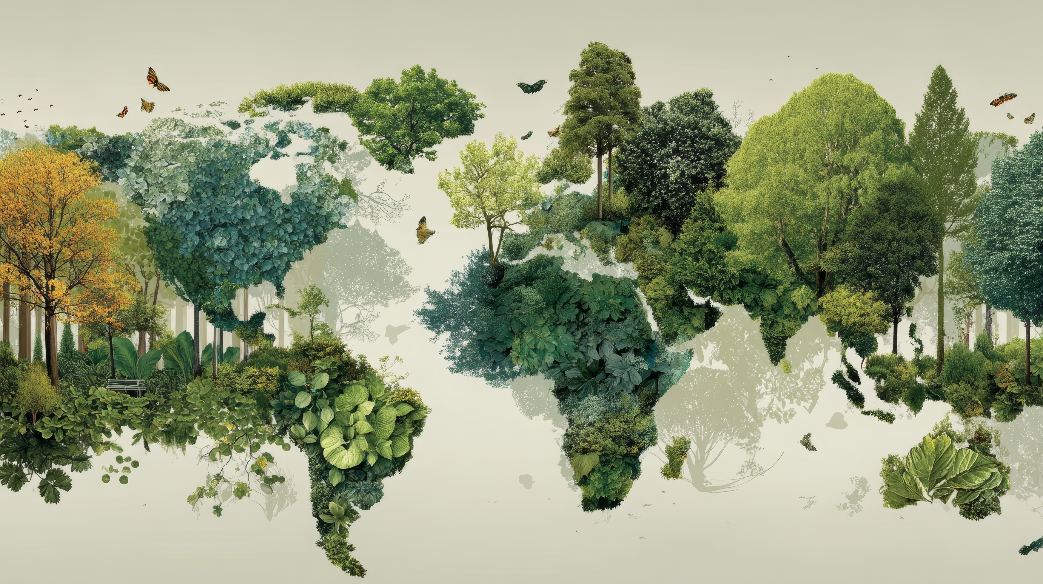



SHORT DEVOTIONAL THOUGHTS
Day 17
Psalm 100
The true beauty of our Existence: We are Created!

Slide 2
Day 17
SHORT DEVOTIONAL THOUGHTS
Psalm 100
CREATION VERSE
The true beauty of our Existence: We are Created!
Psalm 100:3
Know ye that the Lord he is God: it is he that hath made us, and not we ourselves; we are his people, and the sheep of his pasture.

Slide 3
Day 17
SHORT DEVOTIONAL THOUGHTS
Psalm 100
REFLECTIONS
The true beauty of our Existence: We are Created!
Psalm 100 brings us back to the earliest time in human history when we started to build ourselves a name. The very time when man decided to build his own life.

Slide 4
Day 17
SHORT DEVOTIONAL THOUGHTS
Psalm 100
REFLECTIONS
The true beauty of our Existence: We are Created!
To be the god of his own life, we have the story of the fall and Babel. Distinct places in the Bible where human desire for independence, supremacy, and self-rule was openly brought into the open.

Slide 5
Day 17
SHORT DEVOTIONAL THOUGHTS
Psalm 100
REFLECTIONS
The true beauty of our Existence: We are Created!
Man, since the beginning of time, has been determined to self-rule, to be self-governing, and to curate his own life.
However noble, however good, however pure the motivation may be, this is not what man is made for.

Slide 6
Day 17
SHORT DEVOTIONAL THOUGHTS
Psalm 100
REFLECTIONS
The true beauty of our Existence: We are Created!
We are made not for self-rule and governance; we are designed by our Creator for a special dependent relationship with our maker.
This is the strongest and most beautiful relationship that human beings could ever have imagined or experienced.

Slide 7
Day 17
SHORT DEVOTIONAL THOUGHTS
Psalm 100
REFLECTIONS
The true beauty of our Existence: We are Created!
Verse 3 points us to this sole reality about our existence, “Know ye that the Lord he is God: it is he that hath made us, and not we ourselves; we are his people, and the sheep of his pasture.”
We did not make ourselves. We did not exist out of our own intelligence; we were created. There is such a deep perspective that rebukes our human feat.

Slide 8
Day 17
SHORT DEVOTIONAL THOUGHTS
Psalm 100
REFLECTIONS
The true beauty of our Existence: We are Created!
Our true beauty is in the very fact that we are created, we have a Creator, and our life is not for us to govern, but we are designed for a deep relationship with our Maker.

Slide 9
Day 17
SHORT DEVOTIONAL THOUGHTS
Psalm 100
The true beauty of our Existence: We are Created!
KEEP LOOKING TO THE WORKS AND THE LOVE OF OUR CREATOR GOD!

