Slide 1

E MESSAGE OF THE CROSS IS FOOLISHNESS TO THOSE WHO ARE PERISHING, BUT TO US WHO ARE BEING SAVED IT IS THE POWER OF GOD” (1 CORINTHIANS 1:18, NIV).

Slide 2
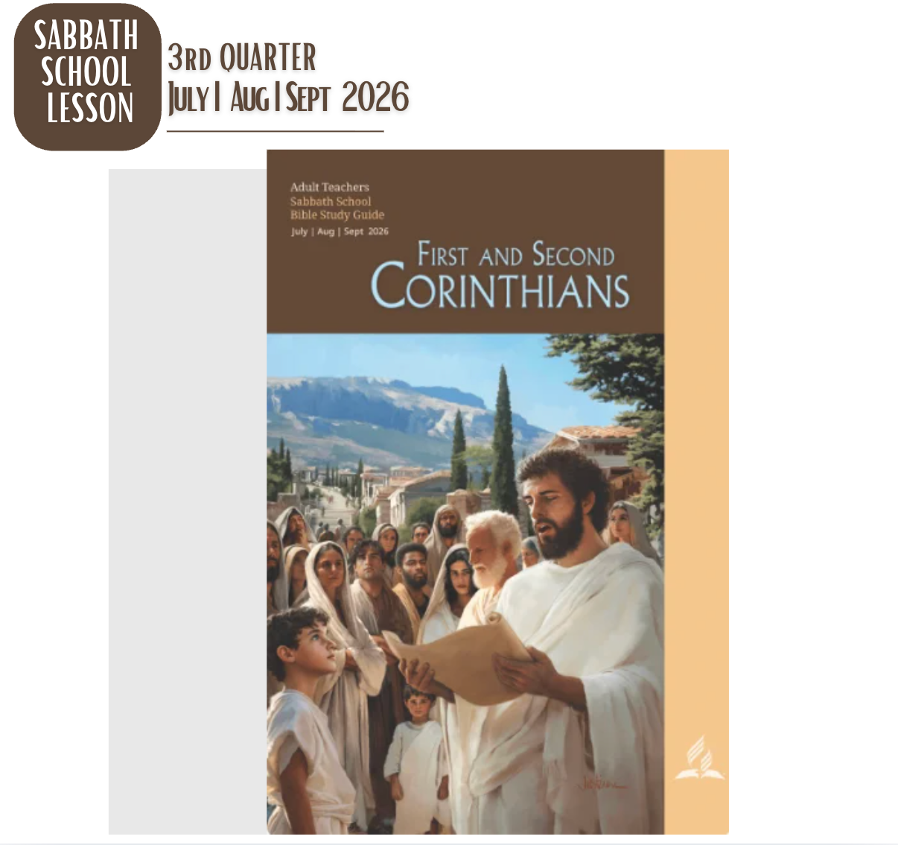

Slide 3
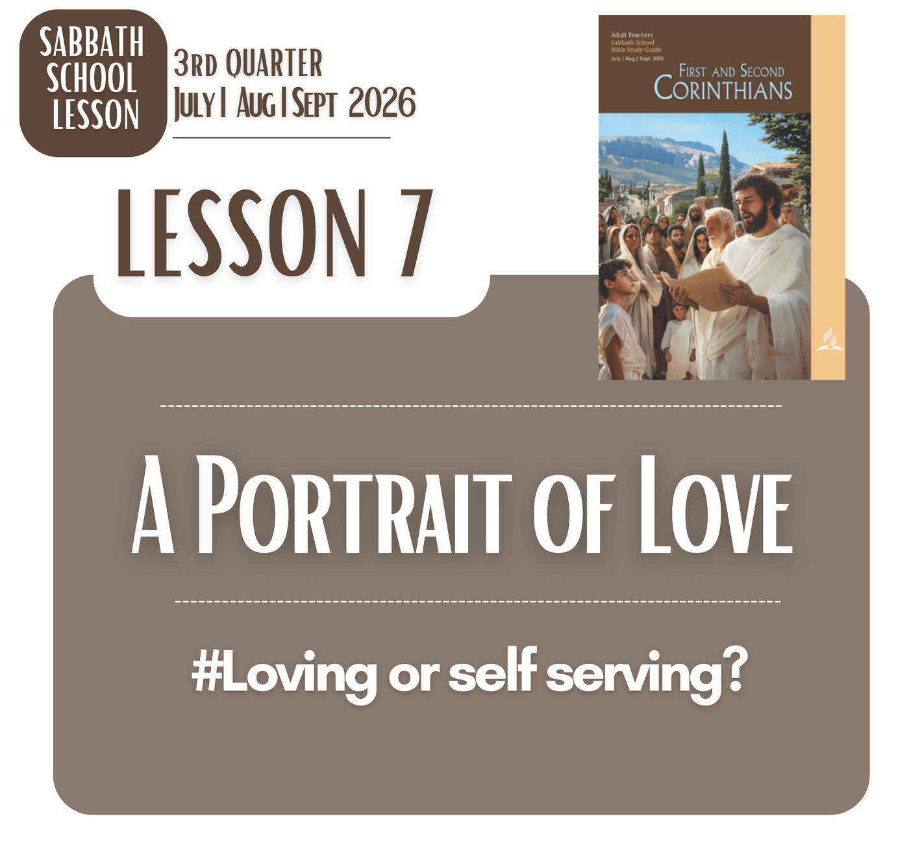

Slide 4

LESSON 7 - A PORTRAIT OF LOVE
MEMORY TEXT
“And now these three remain: faith, hope and love. But the greatest of these is love”
(1 Corinthians 13:13, NIV)

Slide 5
LESSON 7 - A PORTRAIT OF LOVE
OPENING POINTS
BIBLICAL LOVE
Biblical love should not be confused with unconditional approval, tolerance of wrongdoing, or the absence of conflict. First Corinthians 13 critically exposes human weakness: people can be religious, gifted, knowledgeable, and even sacrificial, yet remain self-centered. Love therefore requires more than feelings; it confronts pride, impatience, jealousy, and selfishness and chooses what is good and truthful.
Christ provides the decisive standard of biblical love. Jesus loved sinners without affirming sin, offered grace without abandoning truth, and sacrificed Himself rather than demanding His own way. Thus, biblical love is neither sentimental nor merely human effort. It is a God-centered, Christ-shaped love that transforms the way fallen people respond to one another, with truth, patience, humility, forgiveness, and self-giving grace.

Slide 6
LESSON 7 - A PORTRAIT OF LOVE I SATURDAY AFTERNOON
INTRODUCTION
Biblically, love is more than emotion or human affection. 1 Corinthians 13 reveals our weakness: we may have knowledge, faith, gifts, and religious activity, yet still fail to love. True love requires humility, patience, selflessness, and a willingness to seek another’s good.
A God-centered worldview recognizes that fallen humanity cannot consistently produce this kind of love by itself. Jesus Christ is the fullest revelation of love, not merely through His words, but through His life, sacrifice, forgiveness, and service. Therefore, Christian love is not simply trying harder to love; it is allowing Christ’s love to transform how we think, speak, and treat others.

Slide 7
LESSON 7 - A PORTRAIT OF LOVE I SUNDAY
The Essentialness of LovE
Gospel
THEMES
Jesus’ warning that love can grow cold (Matt. 24:12) exposes the fragility of human love. The cross shows that true love does not ignore sin or weakness but responds with truth, grace, and self-sacrifice. Only Christ can reshape our motives and relationships into this kind of love.
Gospel
LIFE
Biblical love is not simply feeling good toward others or doing good things. Paul challenges religious appearances: gifts, knowledge, faith, and sacrifice can exist alongside pride and selfishness. Without love, even admirable actions may become expressions of self rather than genuine devotion to God and others.

Slide 8
LESSON 7 - A PORTRAIT OF LOVE I SUNDAY
The Essentialness of LovE
ANSWER TO THE MAIN QUESTIONS
Q: What are some times when, indeed, an expression of this kind of love could have made a powerfully positive impression on some-one who needed this love more than anything else?
ANSWER:
Such love can make a profound difference when someone feels rejected, ashamed, lonely, or misunderstood. A patient response instead of criticism, forgiveness instead of resentment, or compassionate presence instead of judgment can restore dignity and open a heart to healing.
Critically, love matters most when it costs us something. Christlike love responds to weakness without enabling wrongdoing. A person may remember one gracious encounter for years because, through it, they experienced something of Christ’s patience, mercy, and unconditional worth.

Slide 9
LESSON 7 - A PORTRAIT OF LOVE I MONDAY
What Love Does
Gospel
THEMES
Paul presents love as a deliberate response to human brokenness, not a pleasant emotion. Patience, kindness, truth, endurance, and hope challenge our natural tendencies toward pride, suspicion, retaliation, and self-protection. Love therefore reveals whether our faith has actually transformed how we treat difficult and imperfect people.
Gospel
LIFE
Yet biblical love is not passive tolerance or blind trust. “Believes all things” does not require ignoring deception, injustice, or harmful behavior. Christ-centered love holds grace and truth together. Jesus welcomed sinners without approving sin, showing that genuine love seeks restoration while remaining faithful to God’s truth.

Slide 10
LESSON 7 - A PORTRAIT OF LOVE I MONDAY
What Love Does
ANSWER TO THE MAIN QUESTIONS
Q: Compare 1 Corinthians 13:4–7 to Galatians 5:22, 23. What ideas in common do you see between the two passages? How can we manifest this kind of love in our own lives?
ANSWER:
Both passages describe love as a Spirit-formed character rather than mere emotion. First Corinthians 13 emphasizes patience, kindness, humility, and endurance, while Galatians 5 highlights love, joy, peace, patience, kindness, faithfulness, gentleness, and self-control. Both challenge religious activity without genuine transformation and point toward Christlike character.
We manifest this love not by human effort alone but through dependence on Christ and the Holy Spirit. Our natural tendencies toward pride, anger, selfishness, and resentment must be surrendered to God. As Christ transforms our motives and responses, His character becomes increasingly visible in our relationships, decisions, and treatment of others.

Slide 11
LESSON 7 - A PORTRAIT OF LOVE I TUESDAY
What Love Does Not Do
Gospel
THEMES
Paul lists what love does not do because sin often appears beneath respectable religious behavior. Envy, boasting, pride, anger, self-interest, and resentment reveal the ego at work. This challenges us to examine not only our actions but also our motives, because even ministry and good deeds can become self-serving.
Gospel
LIFE
Christ-centered love does not excuse sin, tolerate injustice, or ignore boundaries. It refuses to weaponize another person’s failures or celebrate their downfall. Jesus confronted wrongdoing while extending mercy and restoration. Therefore, biblical love is both compassionate and discerning, protecting human dignity without compromising God’s truth.

Slide 12
LESSON 7 - A PORTRAIT OF LOVE I WEDNESDAY
A Portrait of Jesus
Gospel
THEMES
Christ’s love was neither sentimental nor permissive. He welcomed sinners but confronted sin, extended mercy without abandoning truth, and endured suffering without retaliation. Therefore, Jesus is more than an example to imitate—He is the source and standard of biblical love. Our inability to love perfectly reveals our need for His transforming grace.
Gospel
LIFE
First Corinthians 13 is not merely a description of an admirable human character; it exposes how far fallen humanity is from genuine love. Jesus alone perfectly embodies these qualities. His life reveals that love is not produced by personality, morality, or religious activity but flows from complete surrender to God.

Slide 13
LESSON 7 - A PORTRAIT OF LOVE I WEDNESDAY
A Portrait of Jesus
ANSWER TO THE MAIN QUESTIONS
Q: What are other ways that Jesus reveals to us what true love really is?
ANSWER:
Jesus reveals true love by serving rather than seeking status, forgiving rather than retaliating, telling truth rather than merely pleasing people, and sacrificing Himself for sinners (John 13:1–15; Luke 23:34; John 18:37; 1 John 3:16). His love does not ignore sin or weakness; it meets them with grace and calls people toward restoration.
Critically, Jesus shows that true love is self-giving without being self-centered, compassionate without being permissive, and truthful without being cruel. The cross is its clearest expression: Christ loved people who could not repay Him. Thus, Christian love is measured not by what we feel, but by how faithfully we reflect His character.

Slide 14
LESSON 7 - A PORTRAIT OF LOVE I THURSDAY
Faith, Hope, and Love
Gospel
THEMES
Paul exposes how religious gifts can become distorted when separated from Christlike character. The Corinthians were gifted but struggled with envy, pride, offense, and selfish ambition. This warns us that spiritual activity is not reliable evidence of spiritual maturity; the decisive question is whether our lives increasingly reflect Christ’s love.
Gospel
LIFE
Faith, hope, and love orient believers toward God’s ultimate reality. Faith trusts what is unseen, hope anticipates God’s promises, and love reflects His character. Faith will become sight and hope fulfillment, but love remains. Therefore, love is greatest because it most clearly reveals the eternal character of God.

Slide 15
LESSON 7 - A PORTRAIT OF LOVE I THURSDAY
Faith, Hope, and Love
ANSWER TO THE MAIN QUESTIONS
Q: Dwell on the statement “God is love.” How are we supposed to understand exactly what that means? And though we can grasp the idea only in part, why is that phrase such good news for us?
ANSWER:
“God is love” (1 John 4:8) means that love is not merely something God does; it is central to His character. Yet biblical love is not sentimental or permissive. God’s love is holy, truthful, self-giving, and restorative, perfectly revealed in Christ. This corrects our tendency to define love according to human emotions and desires.
This is good news because our love is inconsistent and often shaped by selfishness, fear, or weakness, but God’s character is not. The cross demonstrates that God’s love moves toward sinful humanity rather than abandoning it. We may never fully comprehend divine love, but in Christ we can trust it, receive it, and allow it to transform how we love others.

Slide 16







LESSON 7 - A PORTRAIT OF LOVE
Gospel Reality!
GOD IS LOVE AND THERE IS NO OTHER MUCH BIGGER REALITY!
GOOD NEWS
#Loving or self serving?

Slide 17

LESSON 7 - A PORTRAIT OF LOVE
HEART
of
the
Gospel
Loving or self serving?
People can act from self-serving motives without consciously deciding to be self-serving. Much of human behavior is shaped by unexamined needs, fears, attachment patterns, expectations, and learned ways of relating.

Slide 18
LESSON 7 - A PORTRAIT OF LOVE
HEART
of
the
Gospel
Loving or self serving?
Human love can be genuinely caring while still being unconsciously mixed with self-interest. A person may truly care for someone and, at the same time, unconsciously need that person for affirmation, security, control, or belonging.

Slide 19
LESSON 7 - A PORTRAIT OF LOVE
HEART
of
the
Gospel
Loving or self serving?
Self-serving motives is not necessarily consciously selfish behavior; it can be a distorted form of attachment in which genuine care becomes intertwined with unconscious self-interest. Biblical love calls us beyond merely examining what we do to allowing Christ to transform why we do it.

Slide 20
LESSON 7 - A Portrait of Love
ANSWERS TO FRIDAY’S DICUSSION QUESTIONS:
Q1 : Ê Do you think Paul’s list of positive features of love is exhaus-tive? If not, what other elements would you add to the list?
ANSWER:
Paul’s list is not exhaustive. It highlights essential qualities but does not describe every expression of biblical love. We could add faithfulness, compassion, courage, honesty, humility, forgiveness, justice, and sacrificial service. These qualities are consistent with Christ’s character and show that biblical love involves both grace and truth.
Critically, adding qualities should not turn love into a mere checklist of virtues. The central issue is whether these qualities flow from God’s love revealed in Christ. Genuine love seeks another’s good, confronts wrong when necessary, forgives, protects, and remains faithful even when doing so is difficult or costly.

Slide 21
LESSON 7 - A Portrait of Love
ANSWERS TO FRIDAY’S DICUSSION QUESTIONS:
Q2 : Ë What do you think Paul meant by the command “Pursue love” (1 Cor. 14:1, NKJV)? What does this have to do with what he says in 1 Corinthians 13:4–7?
ANSWER:
“Pursue love” means that love is not passive or merely emotional; it requires intentional practice. Paul connects it with 1 Corinthians 13:4–7, where love is demonstrated through patience, kindness, humility, truth, forgiveness, and endurance. Love must therefore shape behavior, especially when relationships become difficult.
Critically, pursuing love means resisting our natural tendencies toward pride, anger, selfishness, and retaliation. It is not pursuing comfort or approval, but pursuing Christlike character. Through the Holy Spirit, believers intentionally choose responses that reflect Christ, making love a daily discipline rather than merely an ideal.

Slide 22
LESSON 7 - A Portrait of Love
ANSWERS TO FRIDAY’S DICUSSION QUESTIONS:
Q3 : Which characteristic of love do you most need to put into practice in your daily life? Which ones are more necessary in your local church? By the way, why does Paul compare love with such gifts as prophecy, tongues, and knowledge (1 Cor. 13:8)?
ANSWER:
The characteristics most needed in daily life are often patience, humility, forgiveness, and self-control because human weakness easily produces irritation, pride, and resentment. In the church, love must especially express unity, kindness, humility, and willingness to seek others’ good rather than compete for recognition or spiritual status.
Paul compares love with prophecy, tongues, and knowledge because spiritual gifts are temporary and purposeful, while love is enduring. Gifts can become sources of pride when separated from Christlike character. Love reveals whether spiritual gifts are truly serving God’s mission rather than becoming instruments of self-importance or division.

Slide 23
LESSON 7 - A Portrait of Love
ANSWERS TO FRIDAY’S DICUSSION QUESTIONS:
Q4 : Í Paul hints that love is the ultimate solution for the lack of unity among members in Corinth. Why? How does this apply to our churches today?
ANSWER:
Paul presents love as essential to unity because Corinth’s divisions were fueled by pride, competition, jealousy, and self-interest. Love redirects believers from defending personal status to seeking the good of others. It does not erase differences but transforms how those differences are handled within the body of Christ.
This applies directly to churches today. Doctrinal understanding, ministries, gifts, and leadership cannot create lasting unity when pride and resentment remain. Christ-centered love allows believers to disagree without becoming enemies, correct without humiliating, and serve without seeking recognition. Unity becomes possible when Christ, rather than personal preference, becomes the center.

