Slide 1
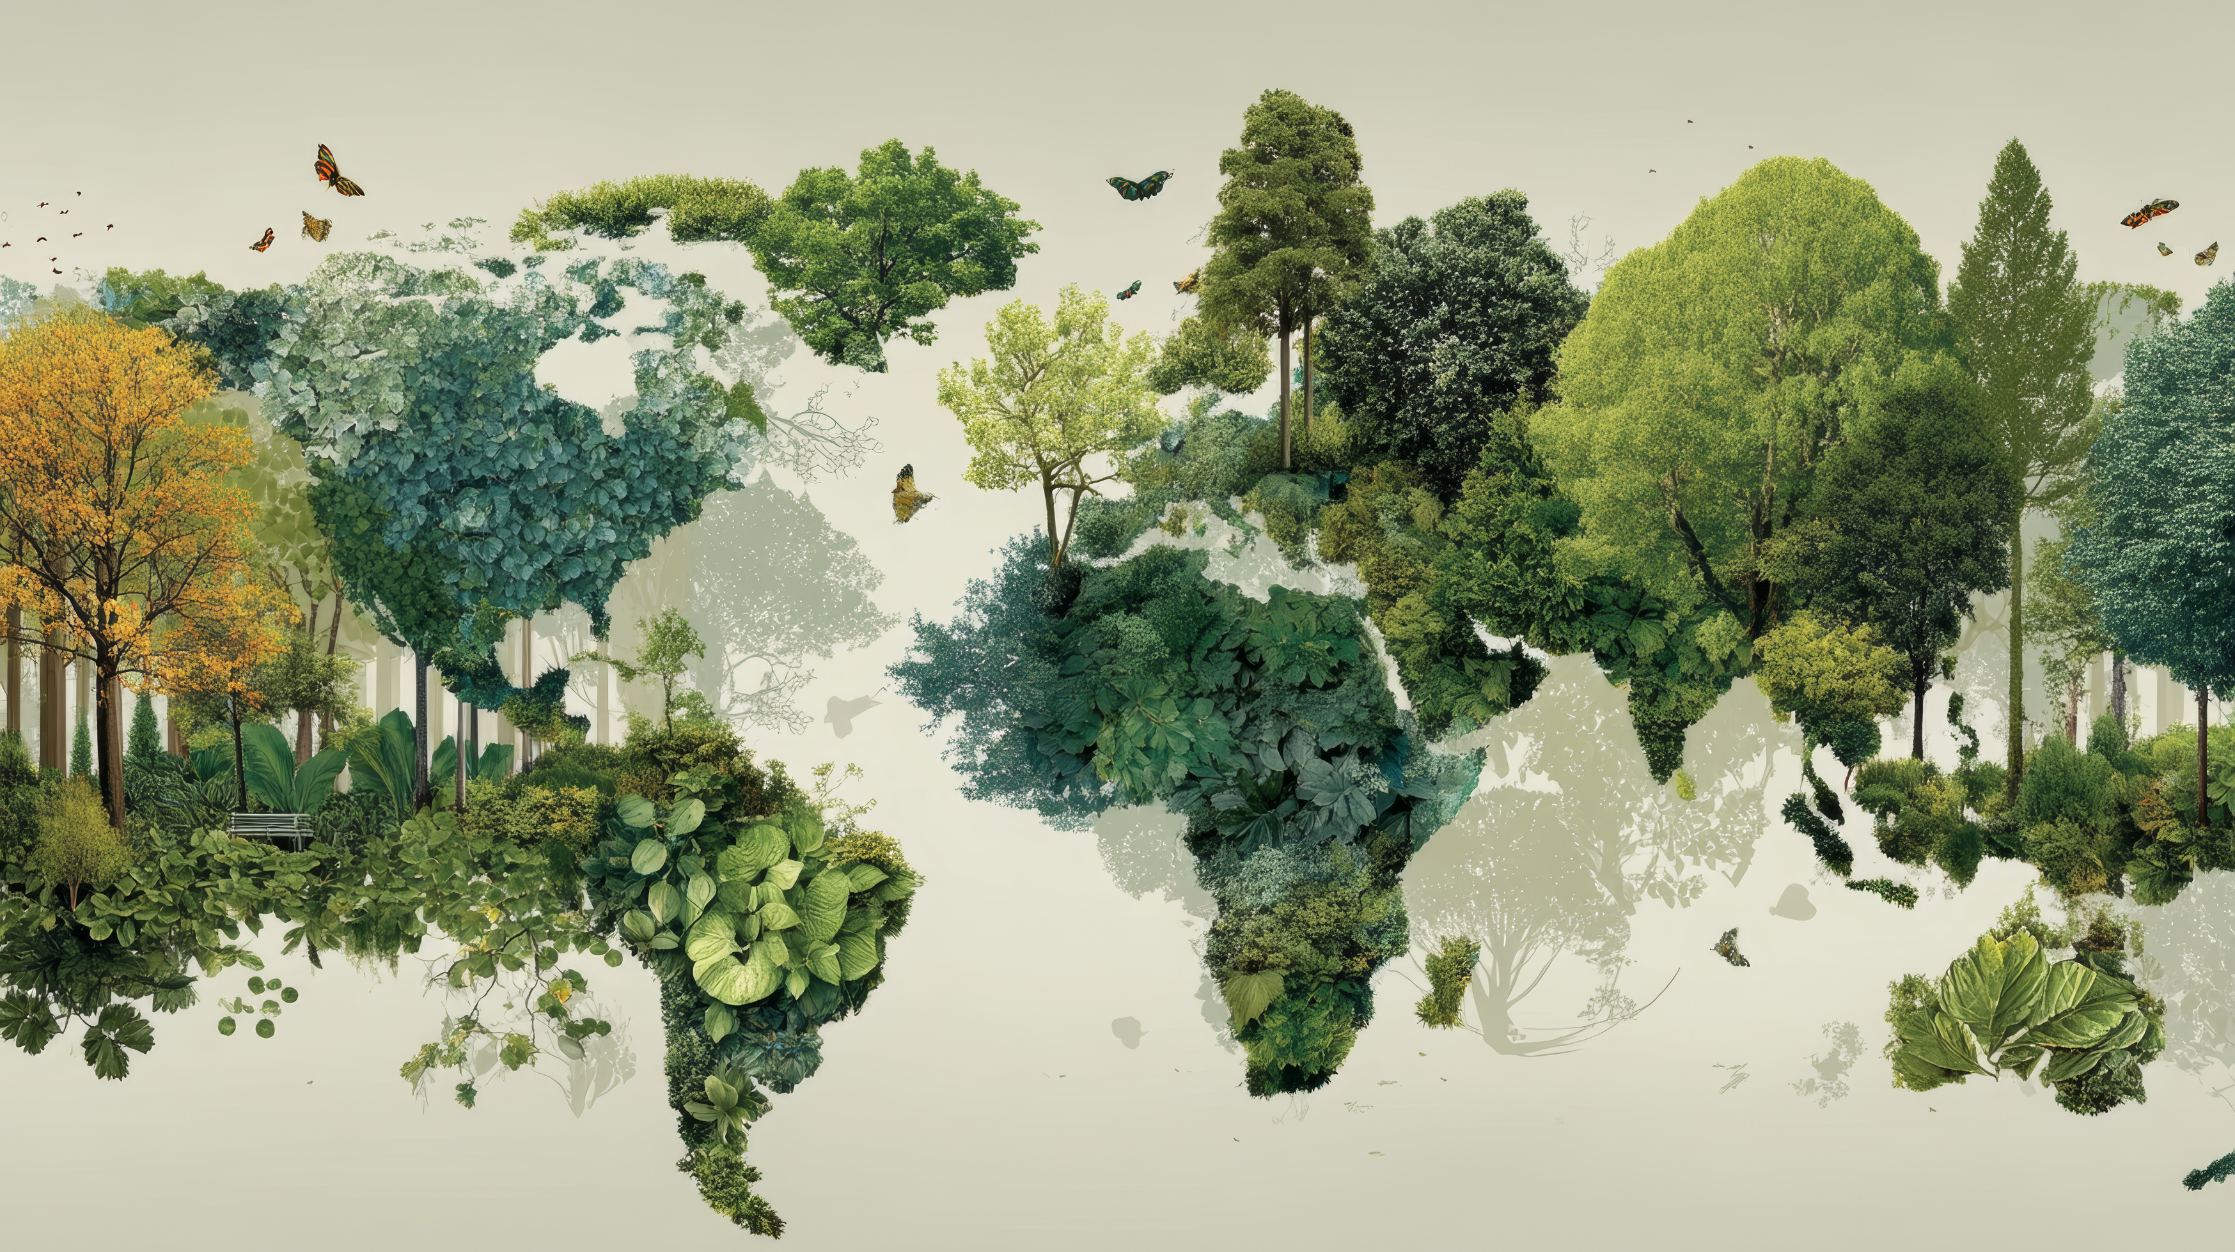



SHORT DEVOTIONAL THOUGHTS
Day 1
Introduction
I have a Creator

Slide 2
Day 1
SHORT DEVOTIONAL THOUGHTS
Introduction
I have a Creator
POINT #1
OUR STARTING POINT IS OUR CREATOR GOD.
Psalm 100:3 —
"Know that the LORD Himself is God; It is He who has made us, and not we ourselves; We are His people and the sheep of His pasture."

Slide 3
Day 1
SHORT DEVOTIONAL THOUGHTS
Introduction
I have a Creator
POINT #1
OUR STARTING POINT IS OUR CREATOR GOD.
We exist for the most beautiful purpose to be in a CLOSE RELATIONSHIP WITH THE ONE WHO FORMED US, FASHIONED US, AND MADE US.

Slide 4
Day 1
SHORT DEVOTIONAL THOUGHTS
Introduction
I have a Creator
POINT #1
OUR STARTING POINT IS OUR CREATOR GOD.
A special relationship where God walks with us and teaches us His heart.

Slide 5
Day 1
SHORT DEVOTIONAL THOUGHTS
Introduction
I have a Creator
POINT #1
OUR STARTING POINT IS OUR CREATOR GOD.
We are formed and made in His love, and in love, He will continue to sustain us.

Slide 6
Day 1
SHORT DEVOTIONAL THOUGHTS
Introduction
I have a Creator
POINT #1
OUR STARTING POINT IS OUR CREATOR GOD.
When sin came, He initiated the rescue plan, the plan that He die, instead of us, so we may be with Him forever and ever.

Slide 7
Day 1
SHORT DEVOTIONAL THOUGHTS
Introduction
I have a Creator
POINT #2
HE SAW US EVEN BEFORE WE EXISTED.
Psalm 139:15–16
15 My frame was not hidden from You When I was made in secret, And skillfully formed in the depths of the earth; 16 Your eyes have seen my formless substance; And in Your book were written All the days that were ordained for me, When as yet there was not one of them.

Slide 8
Day 1
SHORT DEVOTIONAL THOUGHTS
Introduction
I have a Creator
POINT #2
HE SAW US EVEN BEFORE WE EXISTED.
Our unlikely circumstances, broken homes, and severed family relationships may raise a distinct question of “why am I born if things would just be like this?”

Slide 9
Day 1
SHORT DEVOTIONAL THOUGHTS
Introduction
I have a Creator
POINT #2
HE SAW US EVEN BEFORE WE EXISTED.
The broken things of this work never speak of anything about how valued you are by the Creator, Who is watching us form in that broken womb.

Slide 10
Day 1
SHORT DEVOTIONAL THOUGHTS
Introduction
I have a Creator
POINT #2
HE SAW US EVEN BEFORE WE EXISTED.
Our parents, siblings, and we are formed in this broken world, which made us broken people, fragile, vulnerable, and selfish.

Slide 11
Day 1
SHORT DEVOTIONAL THOUGHTS
Introduction
I have a Creator
POINT #2
HE SAW US EVEN BEFORE WE EXISTED.
Yet, these conditions do not forefeit how God has seen us despite our brokenness; He chose to stay close. He saw, He sees, and will continue to see us through!

Slide 12
Day 1
SHORT DEVOTIONAL THOUGHTS
Introduction
I have a Creator
POINT #3
WE ARE NOT SIMPLY HERE; WE ARE IN THE CREATOR’S PLAN.
Psalm 139:13–14
13 For You created my innermost parts; You wove me in my mother’s womb. 14 I will give thanks to You, because I am awesomely and wonderfully made; Wonderful are Your works, And my soul knows it very well.

Slide 13
Day 1
SHORT DEVOTIONAL THOUGHTS
Introduction
I have a Creator
POINT #3
WE ARE NOT SIMPLY HERE; WE ARE IN THE CREATOR’S PLAN.
Psalm 139:13–14
13 For You created my innermost parts; You wove me in my mother’s womb. 14 I will give thanks to You, because I am awesomely and wonderfully made; Wonderful are Your works, And my soul knows it very well.

Slide 14
Day 1
SHORT DEVOTIONAL THOUGHTS
Introduction
I have a Creator
POINT #3
WE ARE NOT SIMPLY HERE; WE ARE IN THE CREATOR’S PLAN.
We don’t simply exist for our dreams, for our plans, for what we see things right, or for our dreams. We are here alive, driven, hopeful, and joyful for the Creator’s plan.

Slide 15
Day 1
SHORT DEVOTIONAL THOUGHTS
Introduction
I have a Creator
POINT #3
WE ARE NOT SIMPLY HERE; WE ARE IN THE CREATOR’S PLAN.
We are here to be one with His heart, to be His steward of the great knowledge of His precious love. We are here as His children fighting every battle against self in His strength.

Slide 16
Day 1
SHORT DEVOTIONAL THOUGHTS
Introduction
I have a Creator
POINT #3
WE ARE NOT SIMPLY HERE; WE ARE IN THE CREATOR’S PLAN.
Our being here is part of God’s great and universal plan to turn people’s hearts into His love. So our prayer is “Show me Your way Lord” (Ps 25:4-5).

Slide 17
Day 1
SHORT DEVOTIONAL THOUGHTS
Introduction
I have a Creator
POINT #4
WHEN I LOOK AT MYSELF, I AM NOTHING. WHEN I LOOK AT GOD, HE IS MY EVERYTHING.
Psalm 95:6
Come, let’s worship and bow down, let’s kneel before the Lord our Maker.

Slide 18
Day 1
SHORT DEVOTIONAL THOUGHTS
Introduction
I have a Creator
POINT #4
WHEN I LOOK AT MYSELF, I AM NOTHING. WHEN I LOOK AT GOD, HE IS MY EVERYTHING.
The very reason for our worship, our thanksgiving, our praise, and our existence is God, our Creator, who willingly became our Savior.

Slide 19
Day 1
SHORT DEVOTIONAL THOUGHTS
Introduction
I have a Creator
POINT #4
WHEN I LOOK AT MYSELF, I AM NOTHING. WHEN I LOOK AT GOD, HE IS MY EVERYTHING.
When we look at everything we have ever done, they are only good because God was with us; without Him, how can a sinful human being ever think of any good?

Slide 20
Day 1
SHORT DEVOTIONAL THOUGHTS
Introduction
I have a Creator
POINT #4
WHEN I LOOK AT MYSELF, I AM NOTHING. WHEN I LOOK AT GOD, HE IS MY EVERYTHING.
When we intentionally look into the glory, the majesty, the justice, the love, the grace, and the beauty of God, we find our very being; we find who we are.

Slide 21
Day 1
SHORT DEVOTIONAL THOUGHTS
Introduction
I have a Creator
POINT #4
WHEN I LOOK AT MYSELF, I AM NOTHING. WHEN I LOOK AT GOD, HE IS MY EVERYTHING.
We are made so we are like God in His compassion, kindness, mercy, and grace. Without the promised presence of God, we remain lifeless dust of the ground; with God, we become the most priceless testimony of God’s majesty.

Slide 22
Day 1
SHORT DEVOTIONAL THOUGHTS
Introduction
I have a Creator
KEEP LOOKING TO THE WORKS AND THE LOVE OF OUR CREATOR GOD!

